Slide 1
Predicting the Next Major League Baseball Pitch Type
ENGR 533 – DEEP LEARNING SYSTEMS
Joel Klein, Jake Sauberman, Ben Perkins
INDIANA UNIVERSITY BLOOMINGTON
December 2021

Slide 2
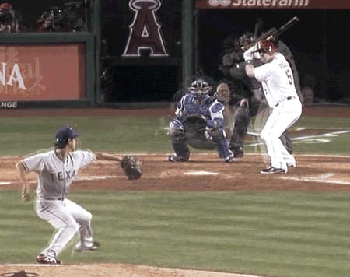
Background
Baseball initiated by pitch from a pitcher to a batter
Common pitch types – Four-seam fastball, Two-seam fastball, Cutter, Slider, Curveball, Changeup
Hitters often guess which pitch they expect to receive
Guess wrong – likely out
Guess right – better chance for positive result
Example pitch overlay of Yu Darvish
Source: Twitter via @MindofStan

Slide 3

Knowing the right pitch has proven to help teams win… by cheating
2017 – Houston Astros stole pitch signs to help win World Series
2018 – Estimated World Series winning team earned $31 million
Could we build an algorithm to predict pitch types?

Slide 4
Data

Slide 5
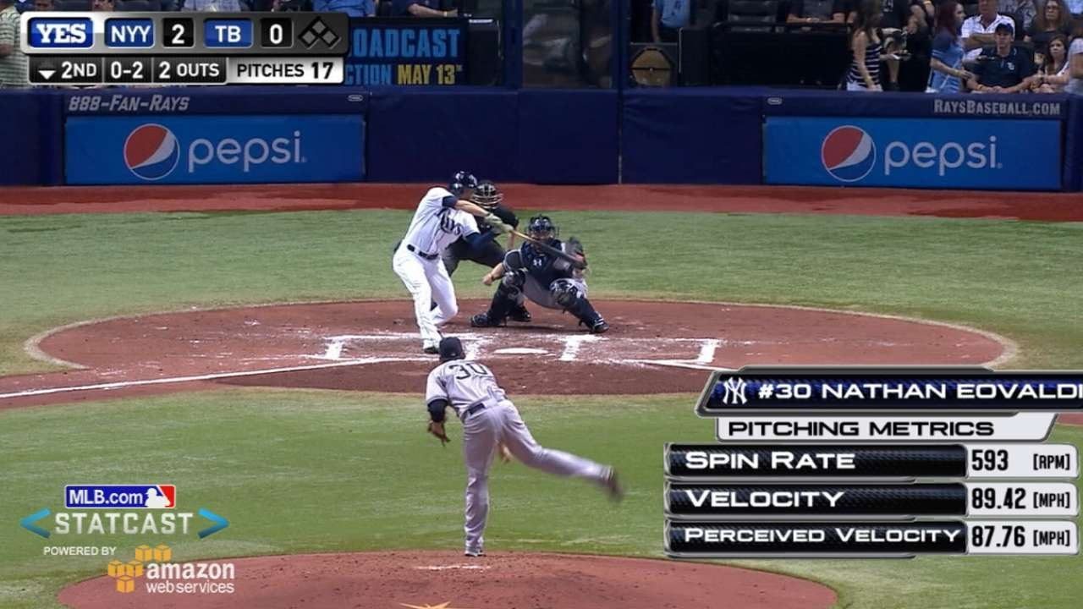
MLB Statcast
MLB Statcast – S.O.T.A. tracking technology for collection and analysis of MLB data
Implemented in 2015
BaseballSavant.com provides MLB Statcast data via external API
Data set contents:
Game state (count, outs, inning, hitter id, pitcher id, r.o.b., etc.)
Pitch results (velocity, spin rate, direction, movement, etc.)
Hitting results (play result – K, 1B, HR, etc., exit velocity, launch angle, etc.)
In game MLB Statcast Measurements
Source: Youtube

Slide 6
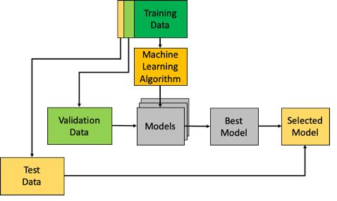
Scope
Regular season pitches (no extra innings)
Following pitch types: Four-seam fastball, Two-seam fastball, Cutter, Slider, Curveball, Changeup
At-bats with no missing pitch class info for any pitches
At-bats featuring batters and hitters accounting for 90% of at-bats in 2017-2018 seasons (assumption pitcher, hitter most important features to model)
Data Splitting:
Training: 2017 – 2018 seasons
Validation: 2019 season
Testing: 2020 – 2021 seasons
Model evaluation framework
Source: ODSC

Slide 7


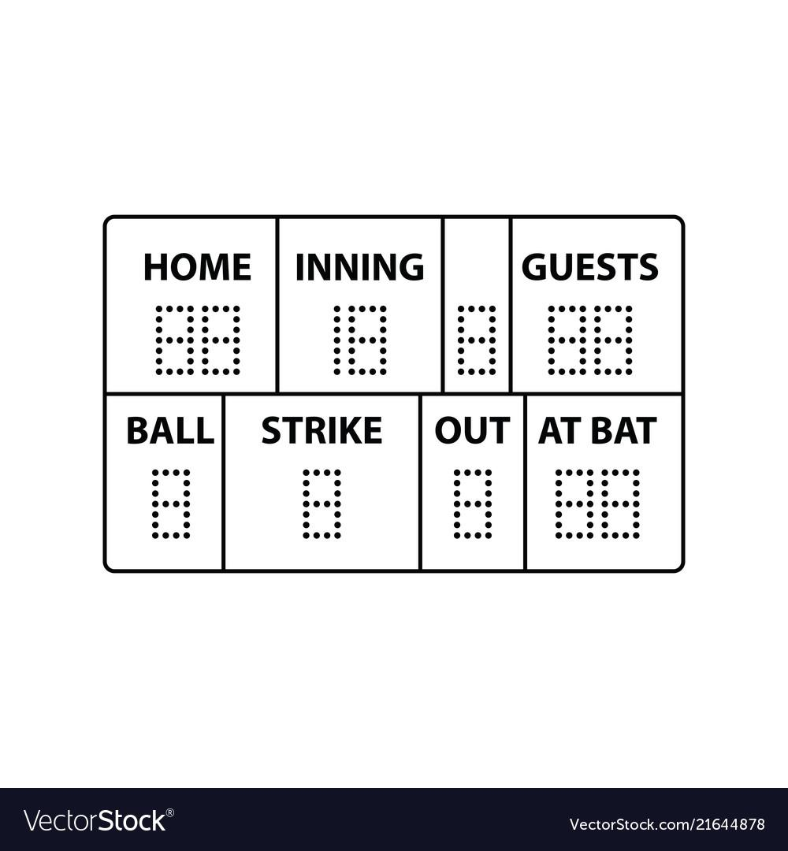

Features
Current Game
State
Previous Pitch
Result
Historical Pitcher
Pitch Selection
Pitcher/Batter Embeddings
Outs
Pitch count
Score
Inning
Top/Bottom
Runners on base
Pitch class
Pitch result
Pitch statistics:
Spin rate
Velocity
Movement
Hit statistics:
Exit velocity
Launch angle
Contact type
Previous 100 pitch distribution
% four seam etc.
Imputed with prior season avg.
Previous 1000 pitch distribution
% four seam etc.
Imputed with prior season avg.
30 dimensional representations of pitcher and batter

Slide 8
Research Questions
How well does a FC network predict next pitch type with current game state info?
Does adding historical pitcher pitch class probabilities improve performance?
Does adding the results of the previous pitch improve performance?
Does adding embedding representations of the pitchers and batters improve performance?
Does using recurrent neural network improve performance via pitch sequencing?
Does using recurrent neural network w/ attention improve performance via pitch sequencing?

Slide 9
Methods

Slide 10
Data Preparation Batter/Pitcher Embeddings
Assumption – Batter & Pitcher ID most important predictors of pitch type
441 batter ids and 512 pitcher ids
Can’t input sparse OHE vectors
30-dimensional embedding representation of pitcher
30-dimensional embedding representation of batter

Slide 11
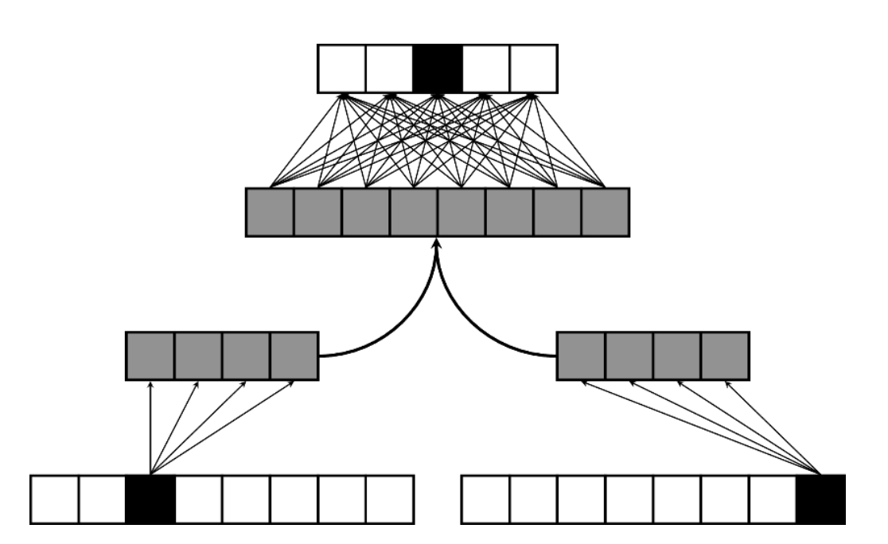
Learning Batter/Pitcher Embeddings
Based on original Paper by M. Alcorn: (batter|pitcher)2vec: Statistic-Free Talent Modeling With Neural Player Embeddings
2017 – 2018 seasons training and 2019 seasons validation
OHE batter and pitcher vectors to predict pitch class
During model building will assess if generated embeddings features add predictive value
Pitch Class
Batter Embedding
Pitcher Embedding
Batter OHE Vector
Pitcher OHE Vector
The (batter|pitcher)2vec model architecture
Source: (batter|pitcher)2vec

Slide 12
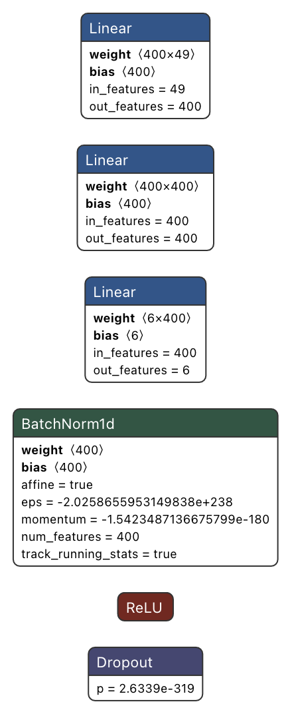

Fully Connected Neural Networks
FC Baseline DNN:
DNN(
Linear(in_features=49, out_features=400, bias=True)
Linear(in_features=400, out_features=400, bias=True)
Linear(in_features=400, out_features=6, bias=True)
BatchNorm1d(400, eps=1e-05, momentum=0.1, affine=True, track_running_stats=True)
ReLU()
Dropout(p=0.25, inplace=False)
)
FC Baseline DNN + prior pitch
Same architecture for both as above, but instead of 49 input features, 156, with 500 hidden dimensions.

Slide 13

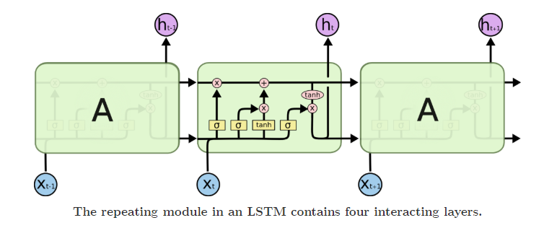
Recurrent Neural Network – LSTM
Pitch
Class
Input: At-bat sequences
Architecture:
3 LSTM Layers:
216 Input Size
500 Hidden Size
0.4 Dropout Rate
Dense Layer:
500 x 6
Dense
+
+
+
Current Game
State
Historical Pitcher
Pitch Selection
Previous Pitch
Result
Pitcher/Batter
Embeddings

Slide 14
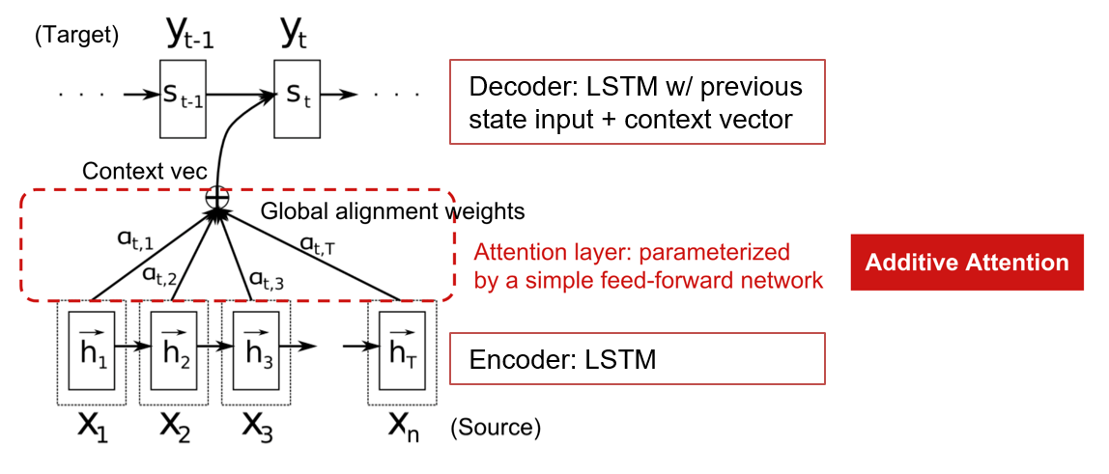
Recurrent Neural Network – LSTM w/ Attention Mechanism
Input: At-bat sequences
Architecture:
Encoder –
LSTM Layer:
216 Input Size
500 Hidden Size
0.3 Dropout Rate
Attention – Additive
Decoder
LSTM Layer:
520 Input Size
500 Hidden Size
0.3 Dropout Rate
Dense Layer:
500 x 6
+
+
+
Current Game
State
Historical Pitcher
Pitch Selection
Previous Pitch
Result
Pitcher/Batter
Embeddings

Slide 15
Results

Slide 16
The best performing model thus far is LSTM
Model | Epochs | Batch Size | LR | Accuracy | Precision | Recall
DNN Baseline | 50 | 2000 | .0001 | 0.4683 | 0.46 | 0.47
DNN Baseline + Prior Pitch | 50 | 2000 | .0001 | 0.4779 | 0.47 | 0.48
DNN Baseline + Prior Pitch + Embeddings | 50 | 2000 | .0001 | 0.4754 | 0.47 | 0.47
LSTM | 30 | 2000 | .0001 | 0.4810 | 0.47 | 0.48
LSTM w/ Attention | 30 | 2000 | .0001 | 0.4798 | 0.46 | 0.48
* Majority class = 36%

Slide 17
Future Directions

Slide 18
With more time we could…
Develop a smarter imputation approach for missing data
Potentially leverage clustering or neural net techniques
Attempt to use longer or multiple input pitch sequences in attention model
Handle the cold start problem for rookie pitchers and hitters rather than excluding
Constrain the problem further to types of pitchers i.e. starters vs. relievers

Slide 19
Questions?

Slide 20
References
M. Alcorn, “(batter|pitcher)2vec: Statistic-Free Talent Modeling With Neural Player Embeddings”, MIT Sloan Sports Analytics Conference. 2018.
URL: https://drive.google.com/file/d/19ulLWQUgpIw-4pK5d7wa1lDhmhTiph37/view.
I. Sutskever, O. Vinyals, Q. Le, “Sequence to Sequence Learning with Neural Networks”, Advances in neural information processing systems. 2014.
URL: https://proceedings.neurips.cc/paper/2014/file/a14ac55a4f27472c5d894ec1c3c743d2-Paper.pdf
J. Shaikh, “Essentials of Deep Learning – Sequence to Sequence modelling with Attention (using python)”, Analytics Vidhya. 2018.
URL: https://www.analyticsvidhya.com/blog/2018/03/essentials-of-deep-learning-sequence-to-sequence-modelling-with-attention-part-i/
A. Persson, “Pytorch Seq2Seq with Attention for Machine Translation”, Youtube. 2020.
URL: https://www.youtube.com/watch?v=sQUqQddQtB4
D. Bahdanau, K. Cho, Y. Bengio, "Neural machine translation by jointly learning to align and translate“, arXiv preprint arXiv:1409.0473. 2014.
URL: https://arxiv.org/pdf/1409.0473.pdf
MLB.com, “Statcast”, 2021.
URL:https://www.mlb.com/glossary/statcast
A. Vaswani, N. Shazeer, N. Parmar, J Uszkoreit, L. Jones, A. N. Gomez, I. Polosukhin, “Attention is all you need”, Advances in neural information processing systems. 2017.
URL: https://arxiv.org/pdf/1706.03762.pdf

